Slide 1

Expand Lego Army
Lego Data Analysis
Final Project for MSCA 31012
By: Lingyi Zhao, Qingyang Mu,
Yixiao Yang, Ke Deng

Slide 2




Meet Our Team
Lingyi (Jannie) Zhao
Yixiao (Shawn) Yang
Ke (Coco) Deng
Qingyang (Ashley) Mu

Slide 3

Content
Executive Summary
Business Use Case
ETL & Database Design
Visualization & Analysis
Recommendations

Slide 4
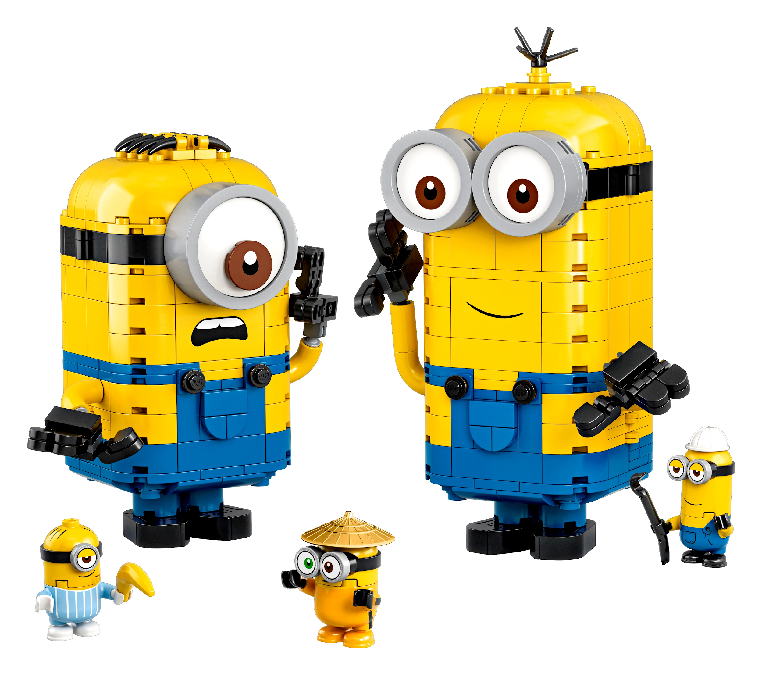
Executive Summary
As one of the most popular and best-selling toys of all time, Lego has become the “world’s most powerful brand”. Over the past 70 years, Lego keeps growing to meet consumer desires and market demands.
The purpose of this project is to help Lego Company track production performance, manage inventory and develop marketing strategies with a global scope.

Slide 5

Business Use Case
For Lego Sellers
How are the Lego markets like in each country?
How to do effective inventory management?
How to predict the prices for each Lego set?
How to improve ratings for each Lego set?
What are some recommended marketing strategies?
For Lego Buyers
What is the average suggested age for lego sets?
What are the most popular sets among Lego players?
Which Lego sets are worth collecting?

Slide 6

Dataset Overview
Inventory data
Brickset: Lego data 2020
349 Themes, 184 colors, 5 version, 2632 inventory sets, 18754 child parts, 2114 parent parts, 13530 sets
Sales data
Brickset: Lego sets
31 unique ages, 12261 sales records, 21 countries, customer reviews, ratings
https://brickset.com

Slide 7
Data Quality Metrics
Completeness
Remove NA, unnecessary columns and group age into ranges.
Accuracy
Data from Brickset -- a professional lego data website
Consistency
Use R and openrefine to adjust the set_id inconsistency
Validity
Data value are within the acceptable range
Timeliness
From 1949 to 2020
Integrity
Stored data in SQL database

Slide 8








Tools For Database Design
Lego Dataset
Relational Database
Data Visualization
Extract, clean, transform
and load data
Data Modeling & Analysis
Reporting & Visualizations

Slide 9




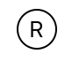
System diagram
Lego Theme
E
T
L
Data Visualization
Lego Sets Info
SQL Analysis
Decision & Recommendation
Sales data
R Analysis
Relational Database

Slide 10



ETL Overview
Production Database
Processing script
Data cleaning
Store the 3NF data into SQL & Mongodb. Result is a dataset of lego fact information included themes, sets, colors, difficulties, and sales information.
Using SQL scripts to create fact tables and link the data together. Also using SQL queries to normalize our data to 2NF first and then did the 3NF as well. After that we store the data to sql and mongodb and insert them also to R to do analysis.
Data files
In our database the id in lego and sales data has some minor difference and we try to update it to uniform.
Data files come from the manufacturer data from 1949 to 2020. Sales data come from a sale record in 21 different countries.

Slide 11
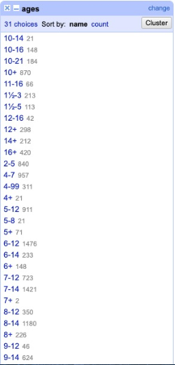
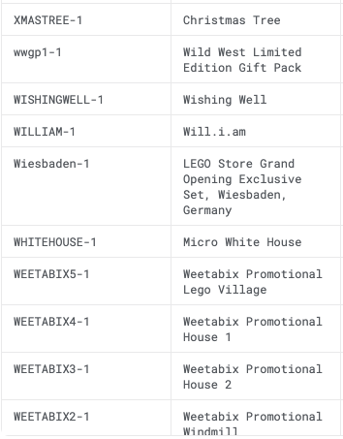
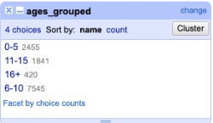
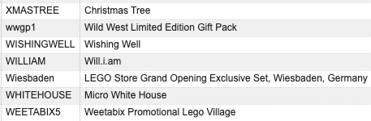
Data preparation
Group ages to avoid duplicated.
Using openrefine to clean the data and uniform the set id in each of the dataset.
Delete the column that we are not going to use and extract all columns into our database.

Slide 12
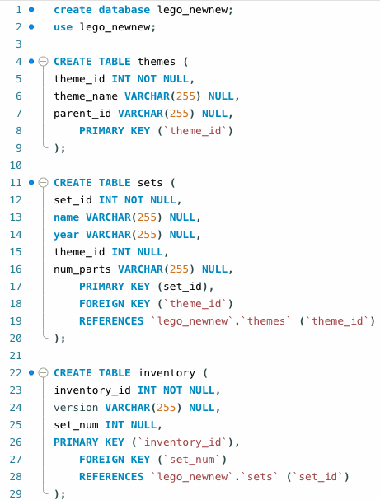
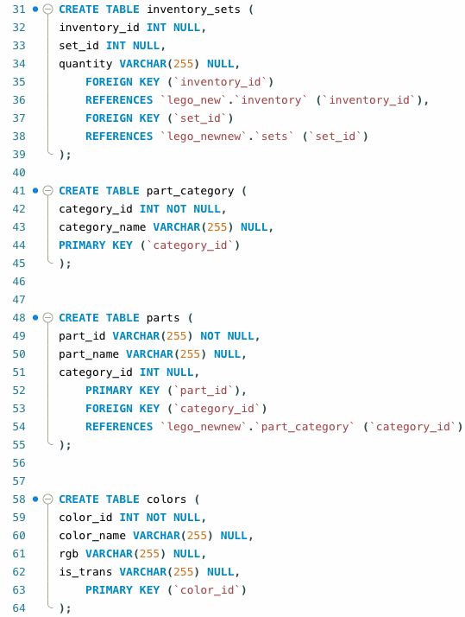
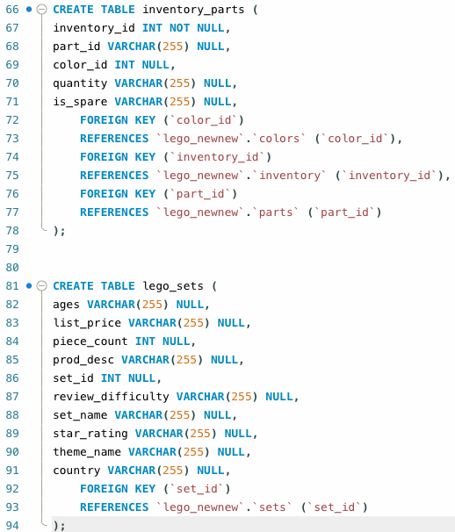
Data process -- DDL

Slide 13
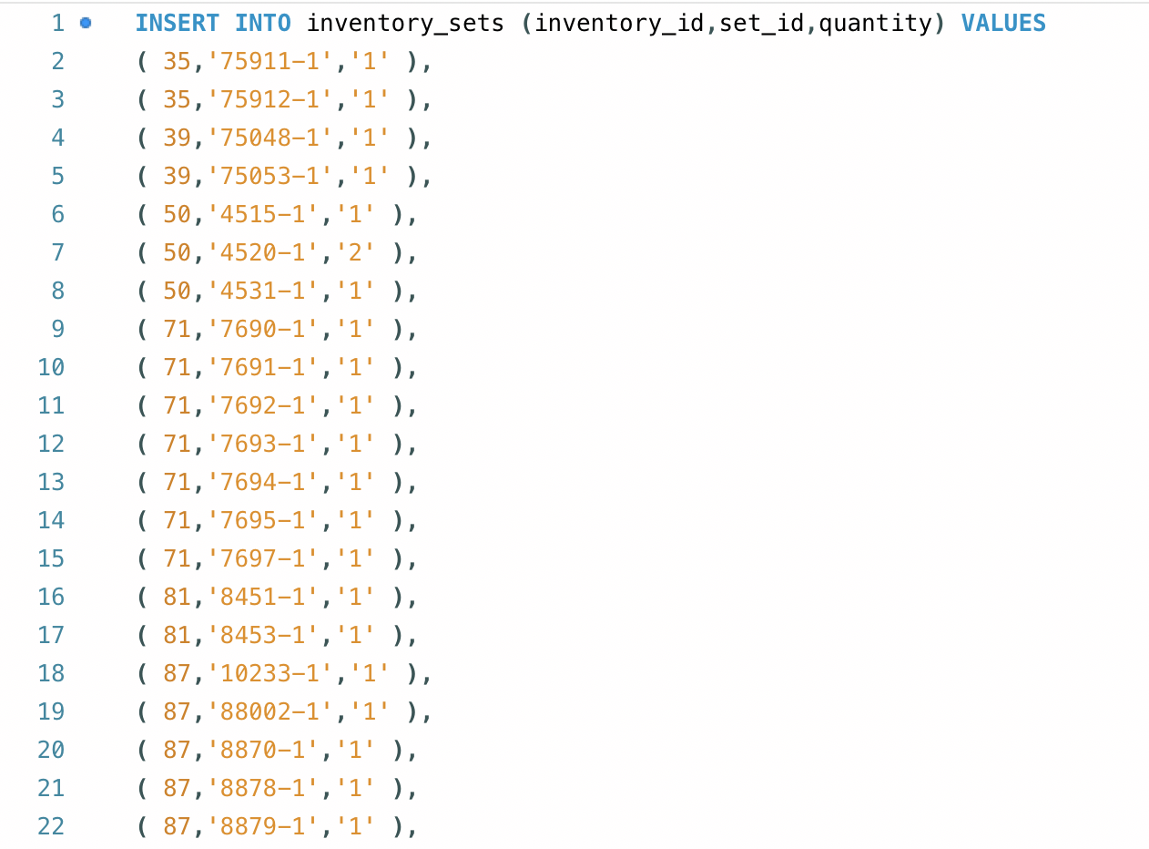
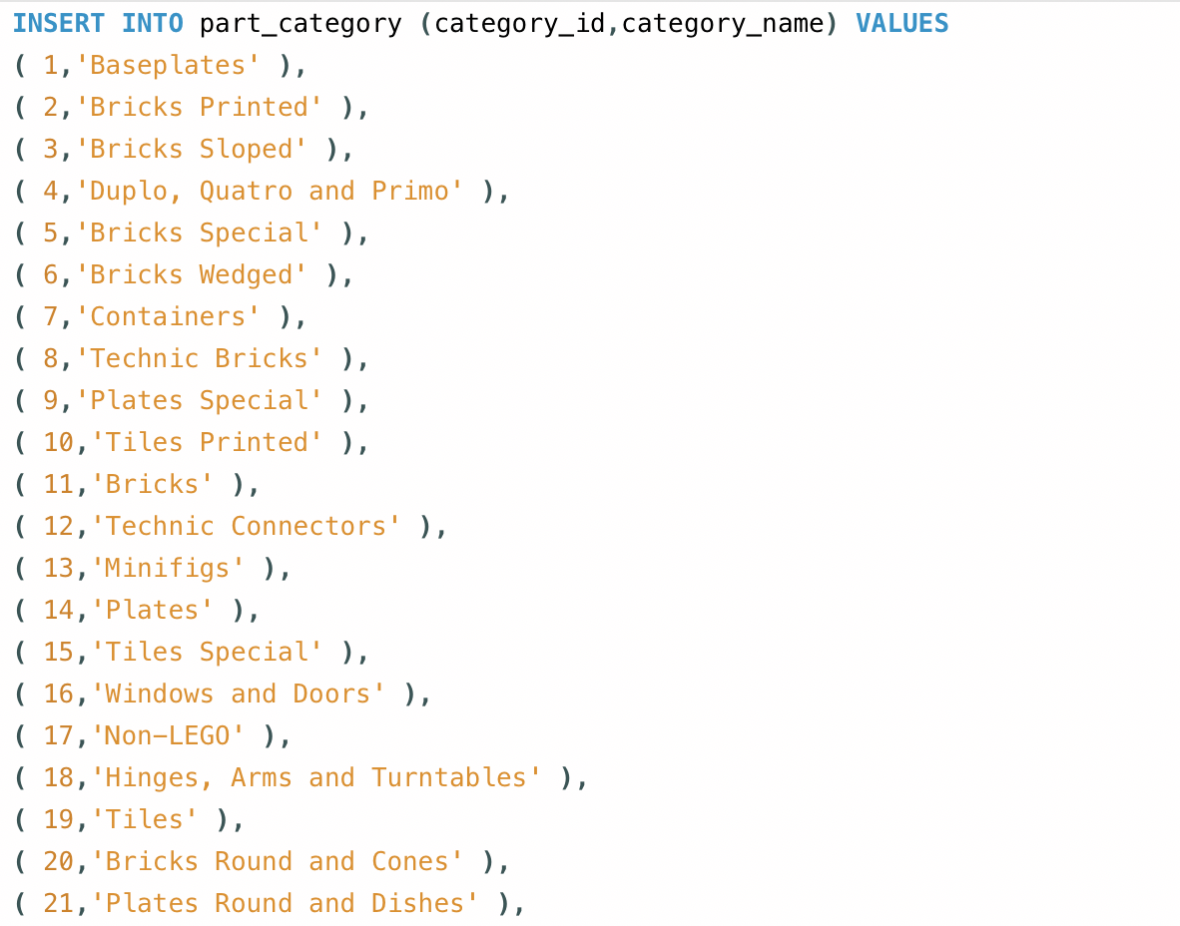
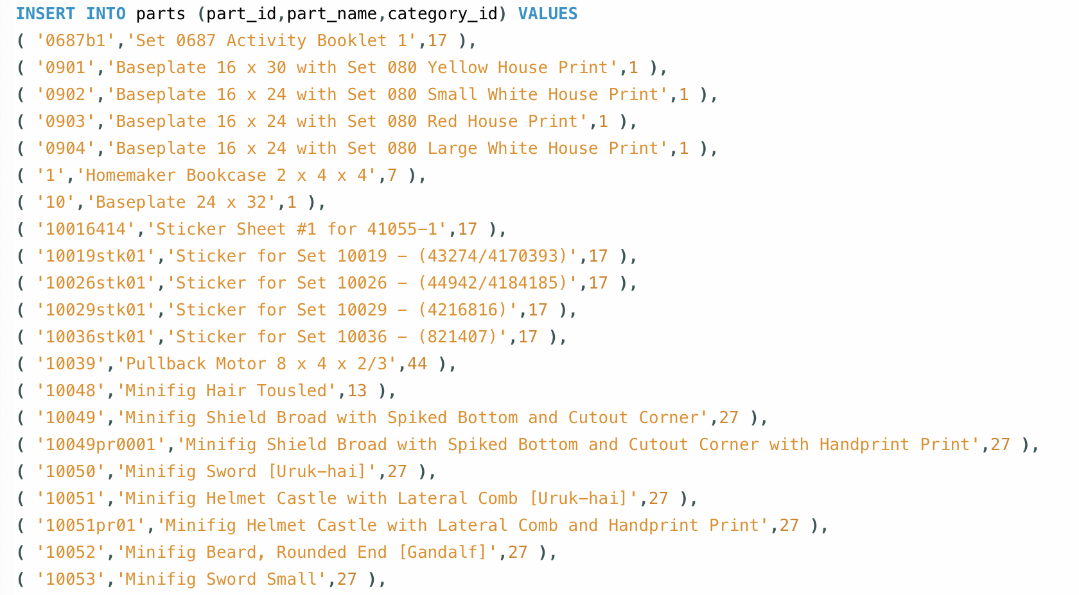
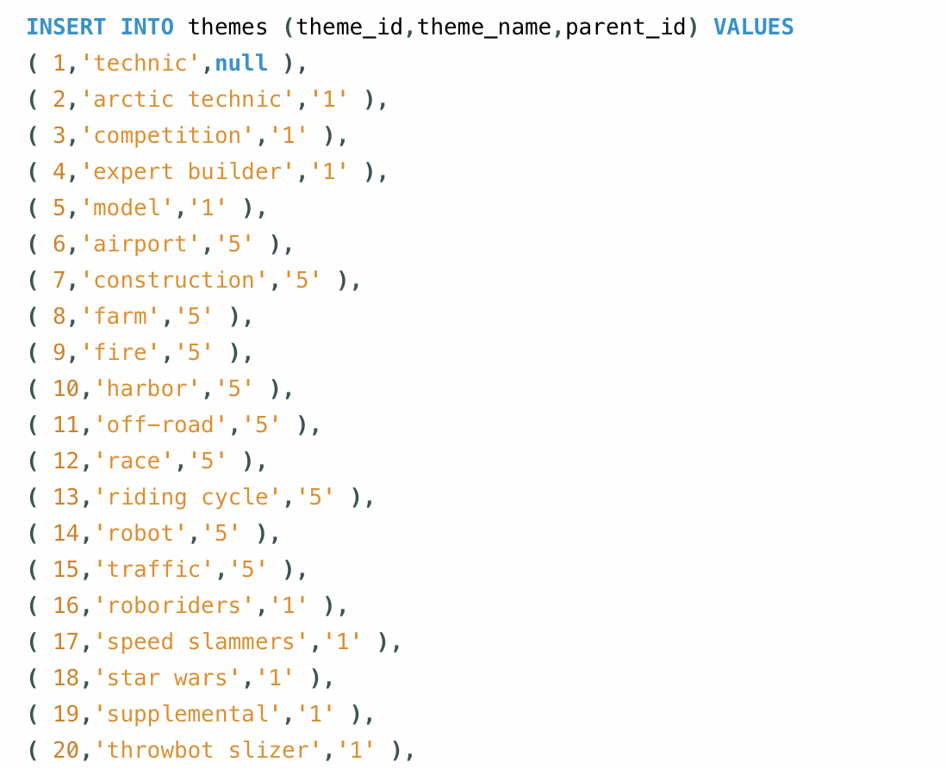
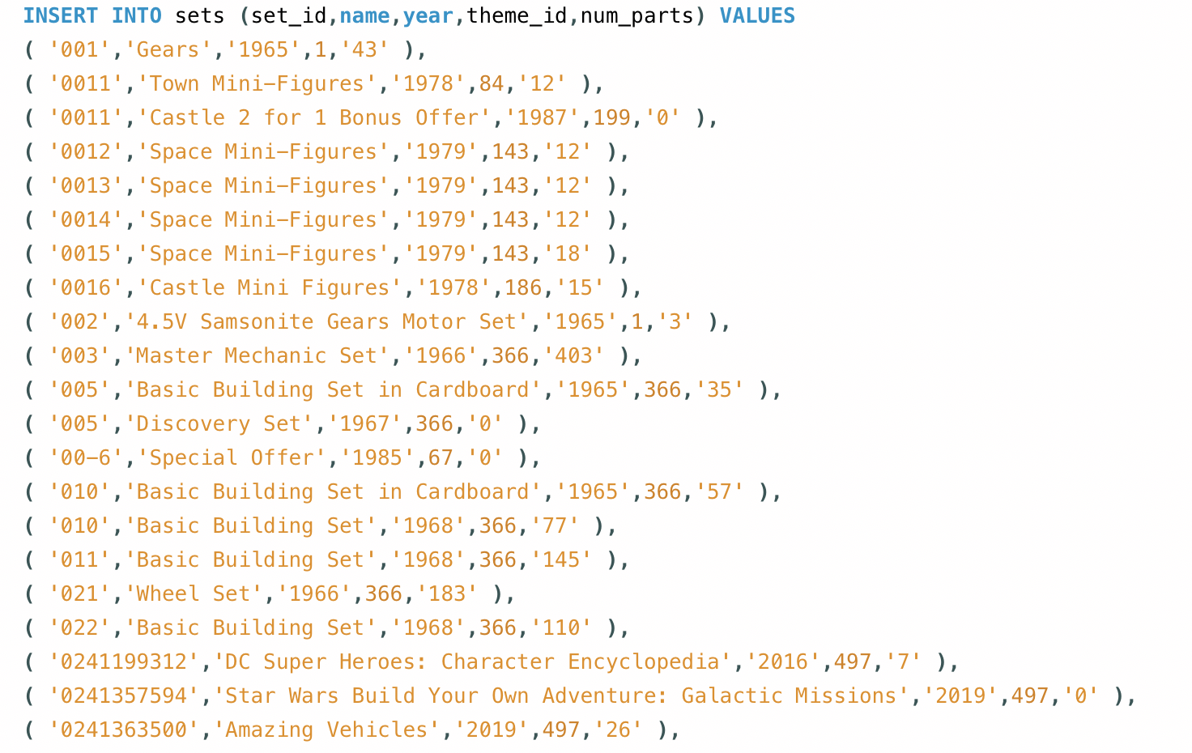
Data process -- DML

Slide 14
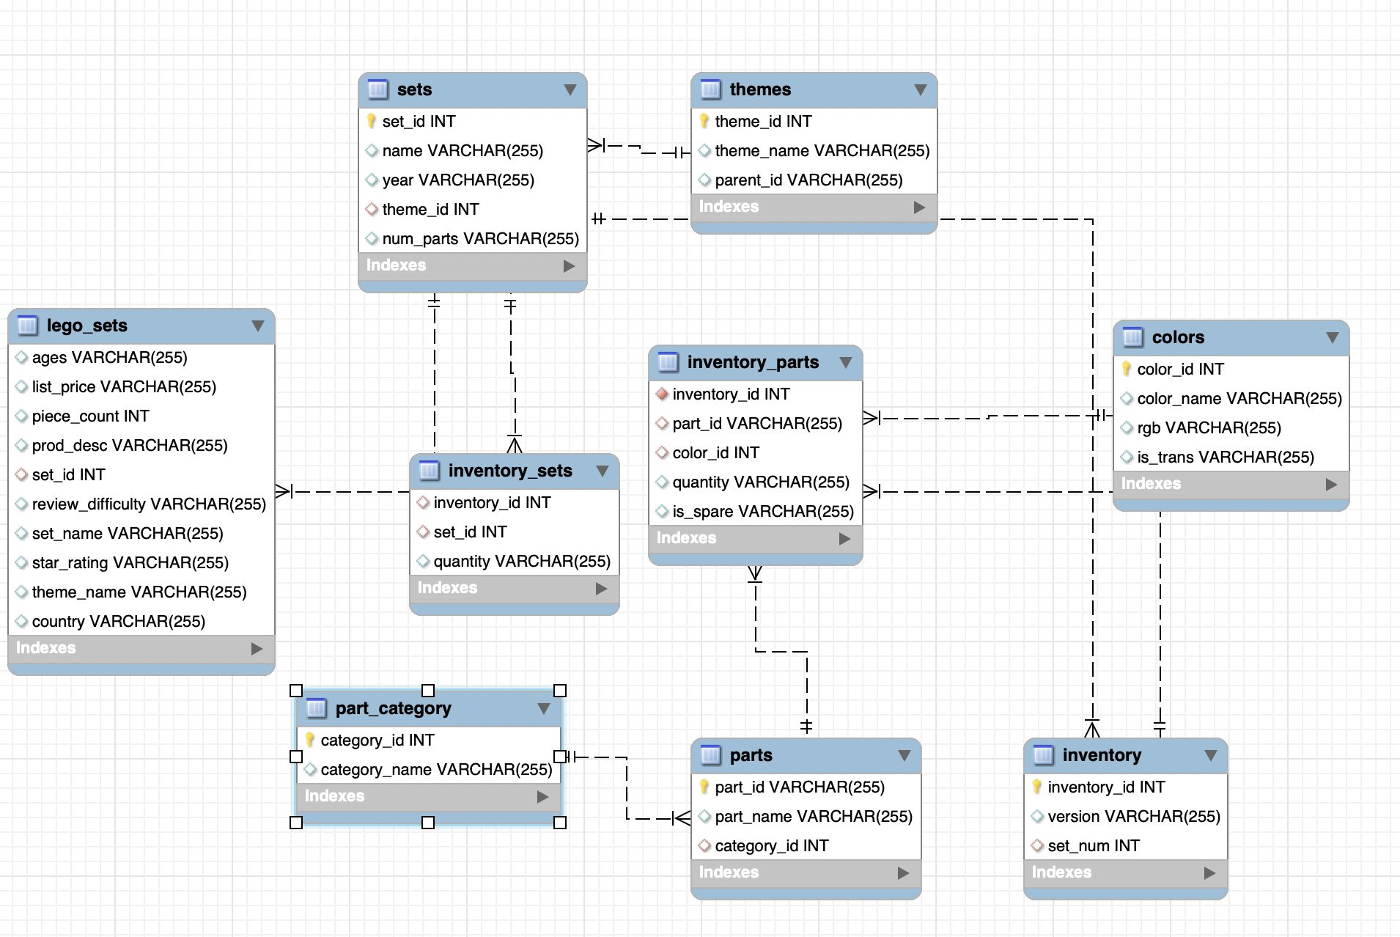
Classic ER Model
Lego_sets: general data of Lego such as reviews, price, year, corresponding ages
Sets: set information of Lego such as number of parts contained, theme of the set, production year
Themes: theme information of Lego
Inventory_parts: information about parts that are stored in each inventory
Colors: color information of each part
Inventory: information of the inventory
Part_category: a normalized table of part
Parts: part information which includes category and part_name
Inventory_sets: table that connects inventory and sets

Slide 15
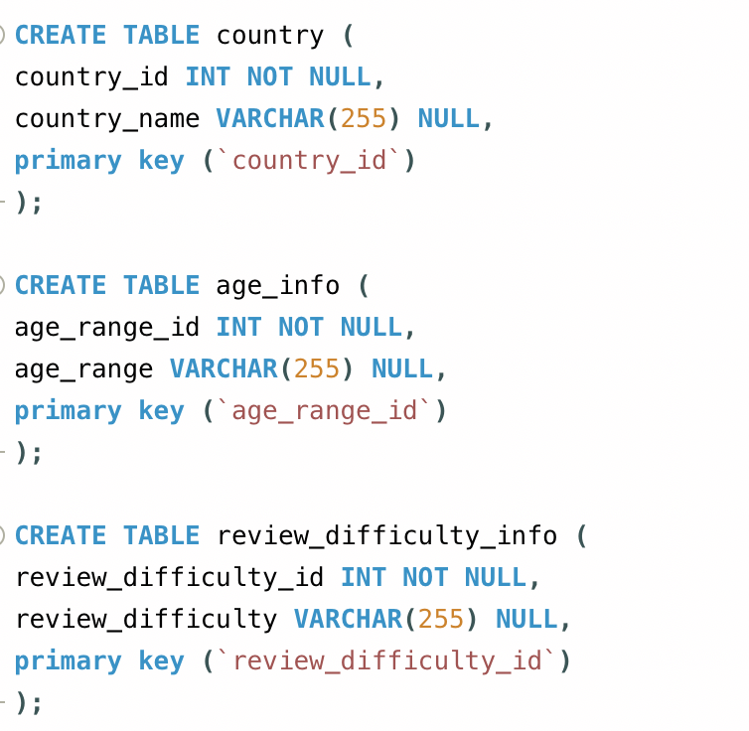
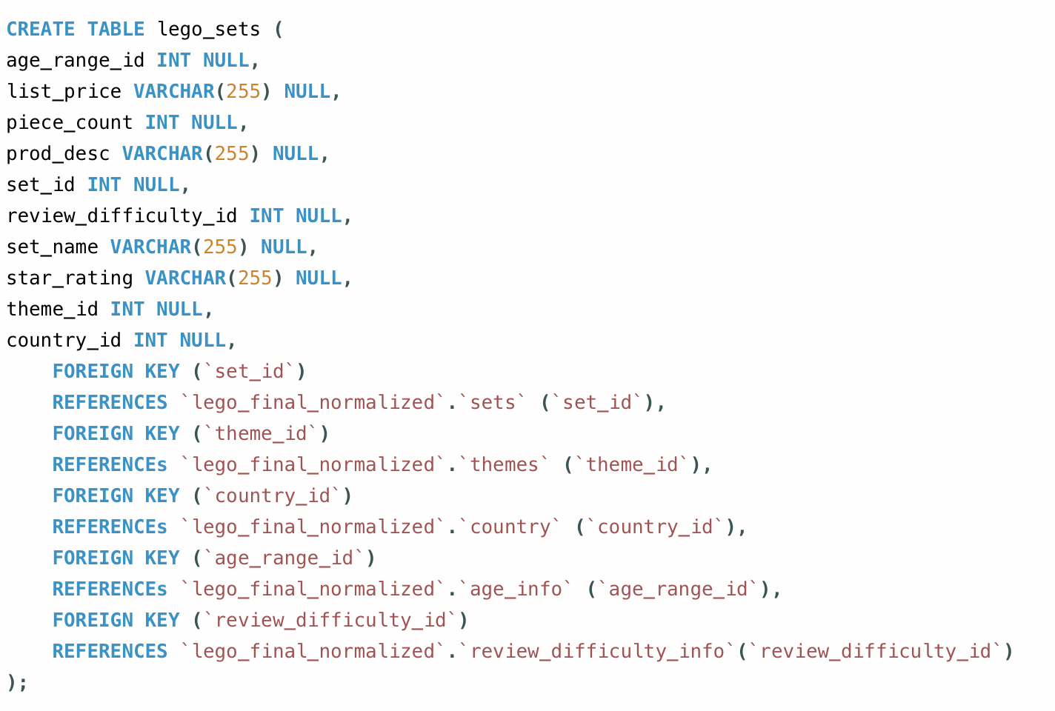
Normalizing ER Model

Slide 16
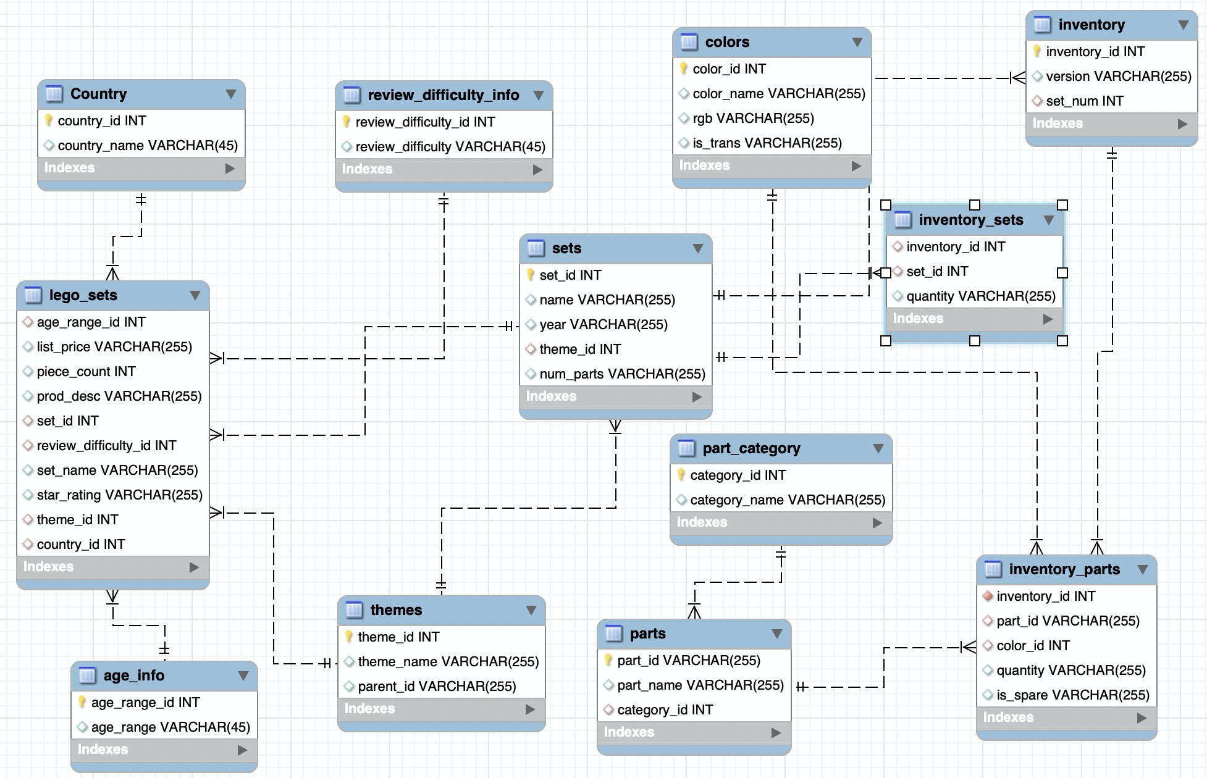
Production Database
Normalized Data
Primary normalized relationships include review_difficulty_id, age_range_id, and country_id in the lego_sets table. Update anomaly, Insert Anomaly, and Delete Anomaly can be avoided with the normalization.

Slide 17
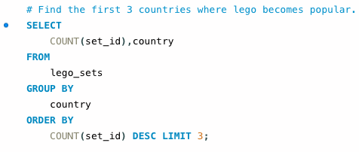
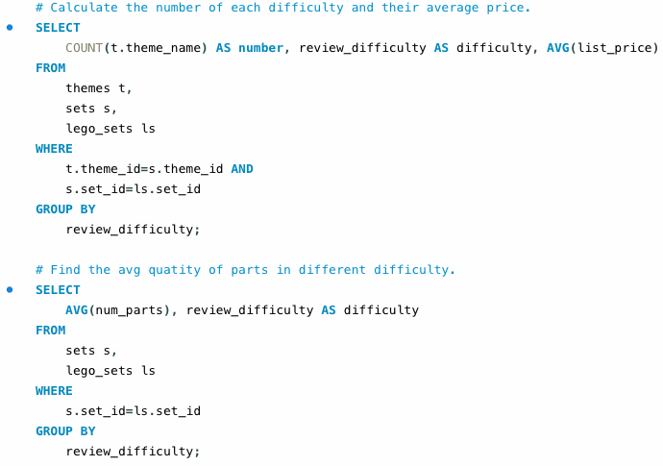
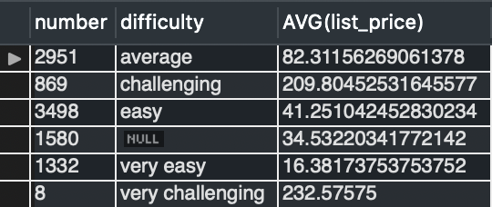
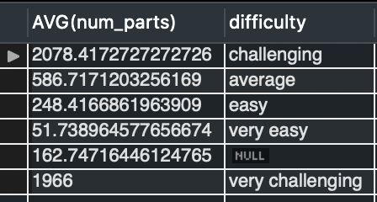
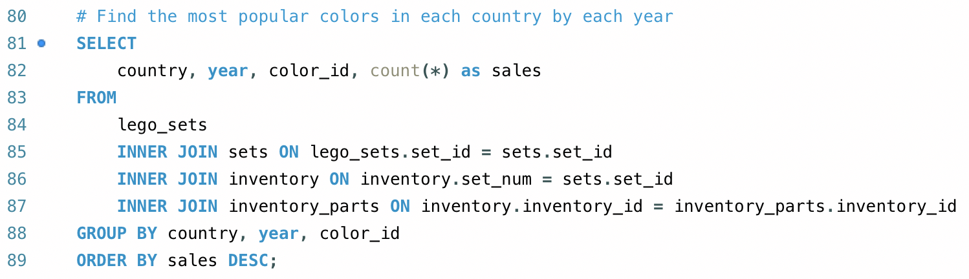
Applied SQL Queries

Slide 18

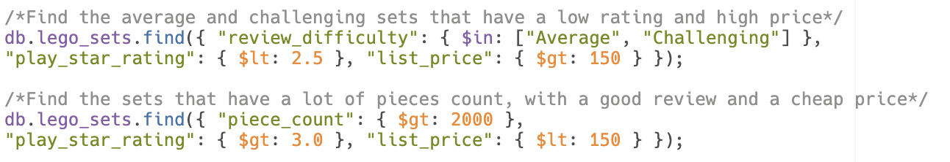
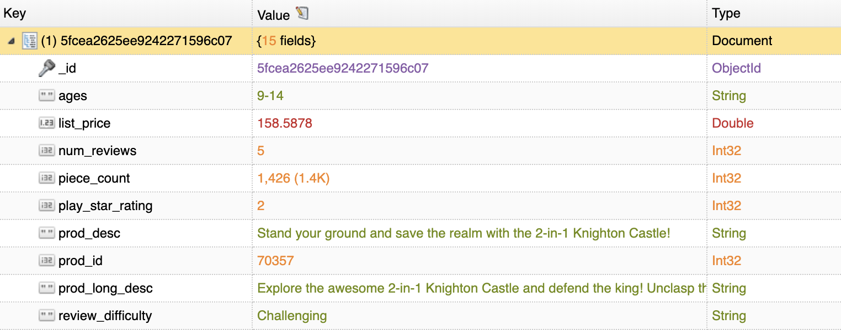
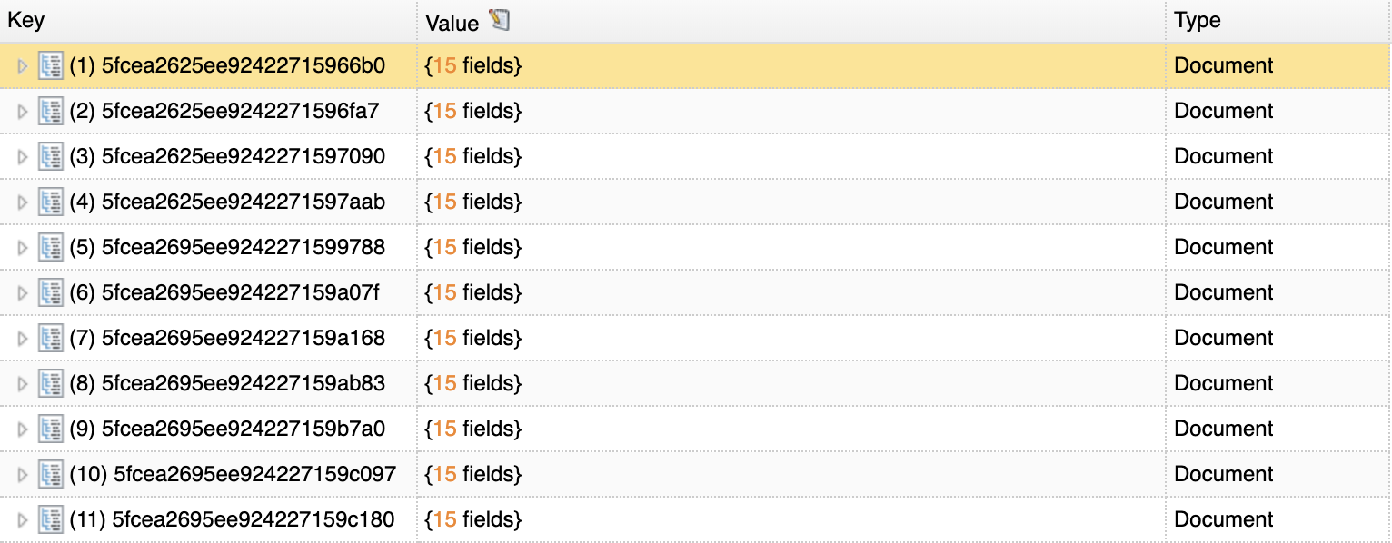
Applied MongoDB Queries

Slide 19
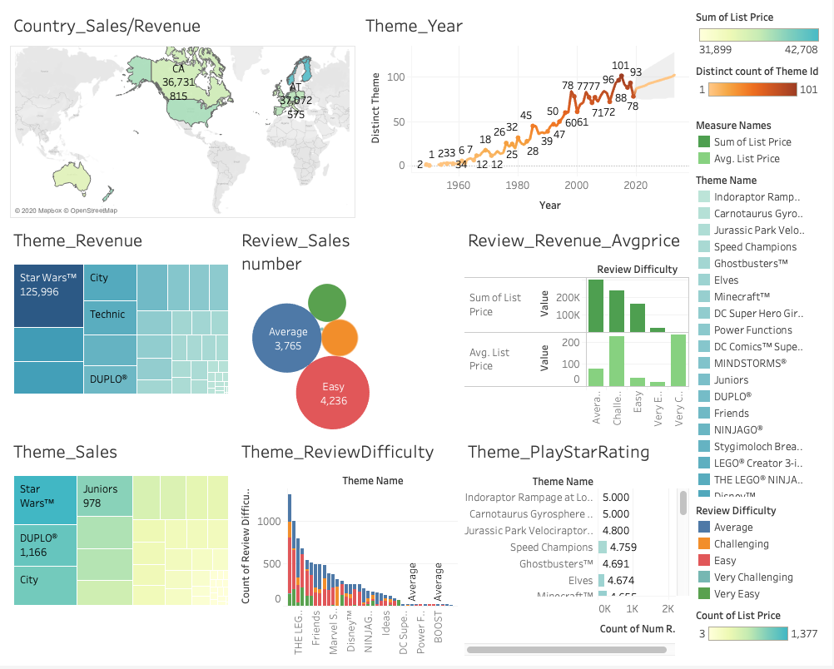
Data Visualization

Slide 20
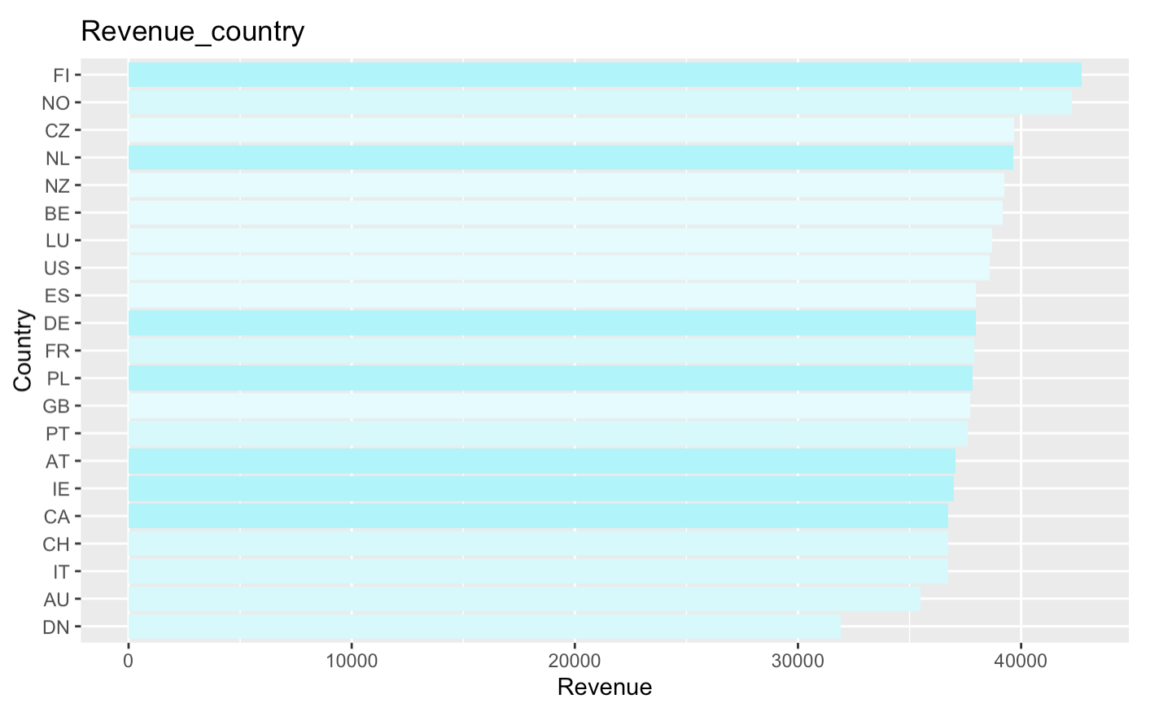
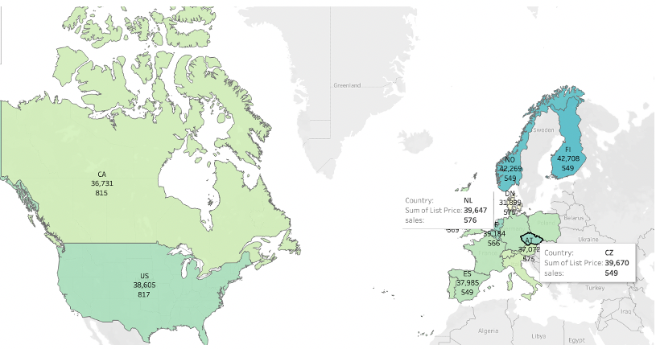

Sales Revenue & Numbers in Countries
Top 3 countries with the most revenue
Finland(FL): $42708
Norway(NO): $42269
Czech Republic(CZ): $39670
The least revenue
Denmark(DN):$ 31899
Top 3 countries with the most sales
United states(US): 817
Canada(CA): 815
Netherlands(NL): 576
Relationship: not positively correlated
Finland, Norway and Czech Republic sell less numbers of lego sets but earn more revenue than other countries.
Denmark: may need promotion strategy to increase sales revenue

Slide 21
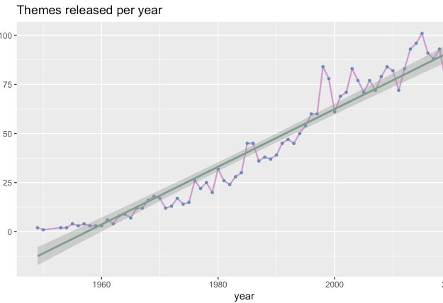
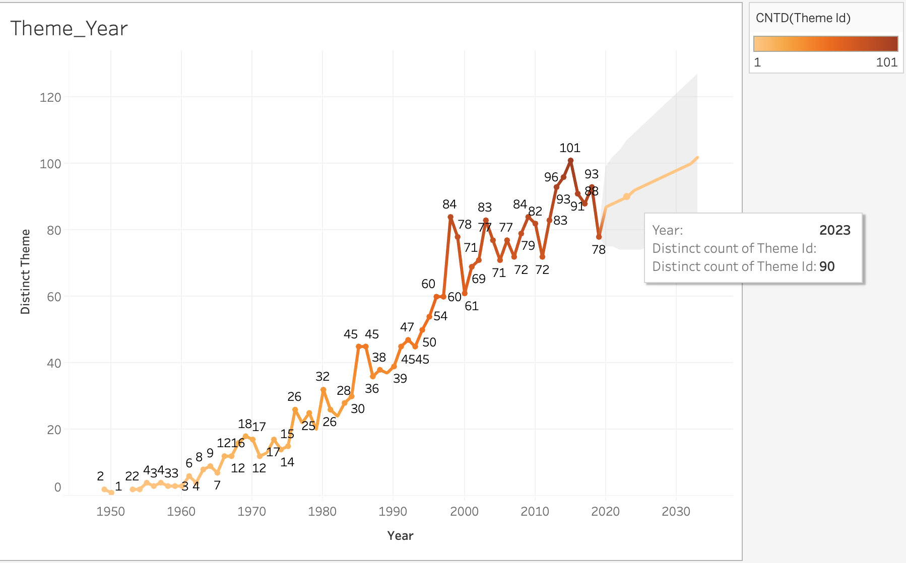
Theme(unique) each Years
Trend before 2020:
From the line in the first graph (R programming), the number of themes released each year have generally increased.
However, there is a fluctuation from 2004 to 2010. Those years represent difficult period for The Lego Group, when the company teetered on the brink of bankruptcy before picking up the pieces.
Trend after 2020:
From the forecasting part on the second graph (Tableau), the trend after 2020 is upward. For example, the number of theme which will release in 2023 is 90.

Slide 22
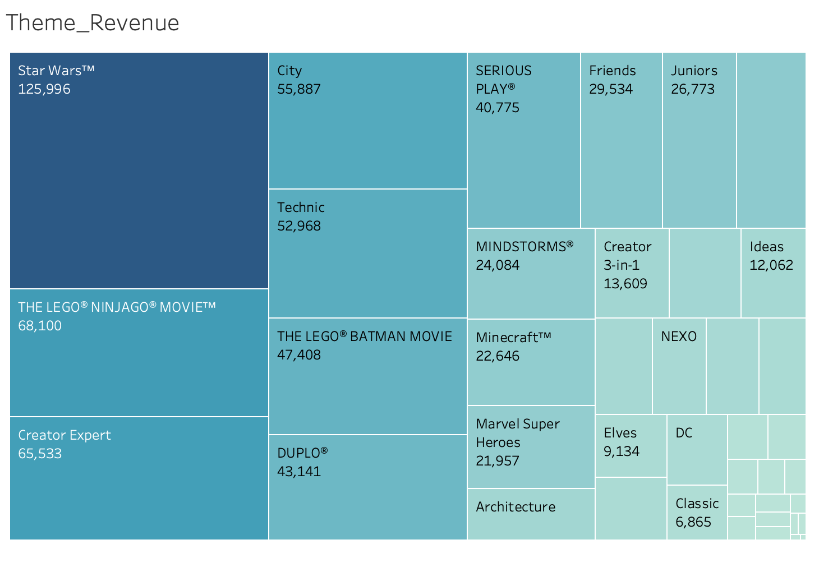
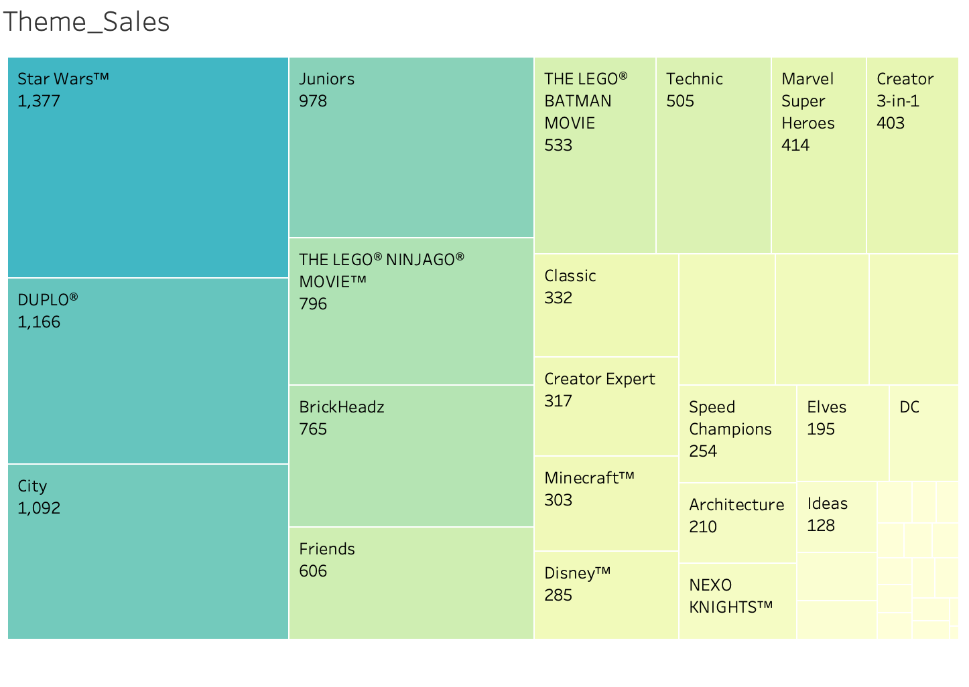

Sales Revenue for Themes
Top 5 Themes with the most revenue:
Star Wars: $125996
The Lego ninjago movie: $68100
Creator Expert: $65533
City: $55887
Technic: $52968
Sales Number for Themes
Top 5 Themes with the most sales number:
Star Wars: 1377; Duplo: 1166; City: 1092;
Junior: 978; The Lego ninjago movie: 796
Star Wars:the most popular theme
Duplo: high sales number,lower price (for age 1-5)
The Lego ninjago movie:
Higher price, low sales numbers (for age 8 or older)

Slide 23
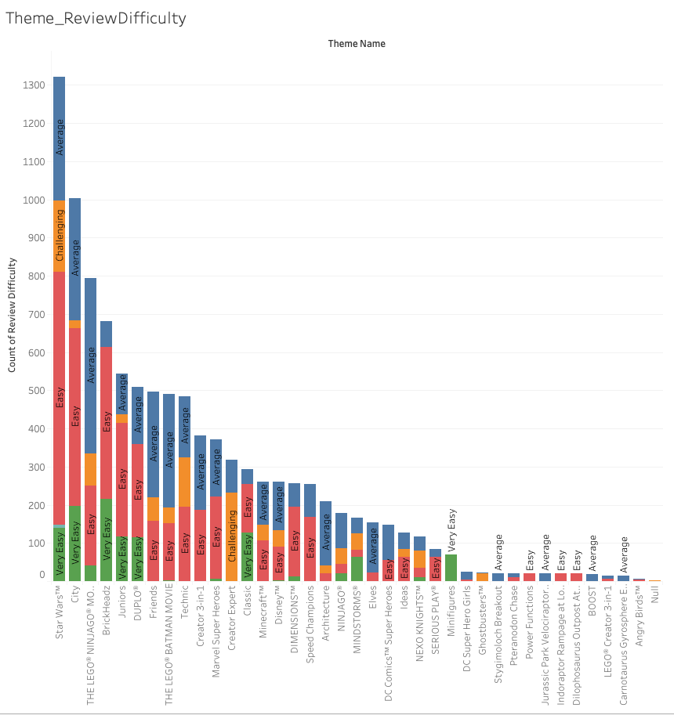
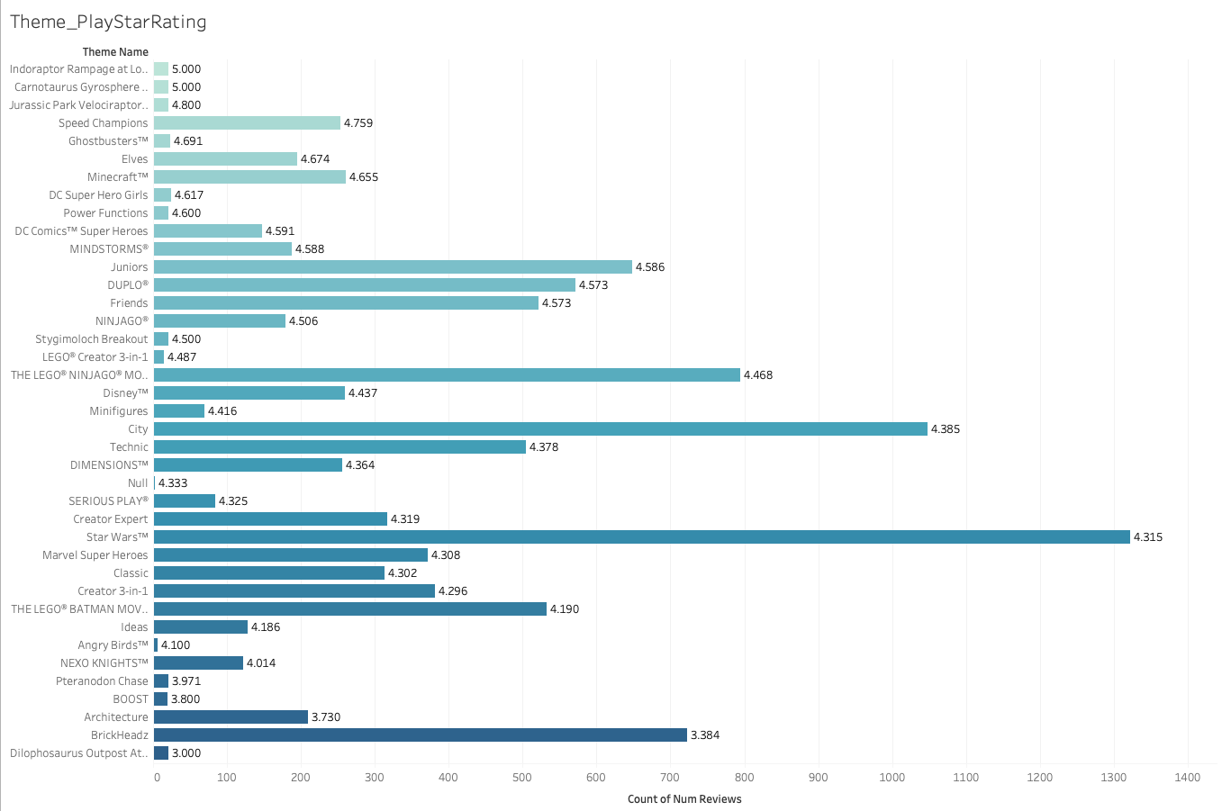

Difficulty Level & Play Star Rating for Theme
Top themes (number of each reviewed difficulty level)
Star wars: easy > average > challenging City: easy > average > very easy
Top themes (number of review/play star rating)
Star wars: high number, comparatively low rating (4.315) City: high number, comparatively low rating (4.385)
Suggestion: Some customers who buy top themes only because of the popularity and they found it is not worth playing at the end. Increase playability for popular themes and apply marketing strategy to promote other niche themes. For example, Indoraptor Rampage at Lockwood Estate (high rating/low review number).

Slide 24
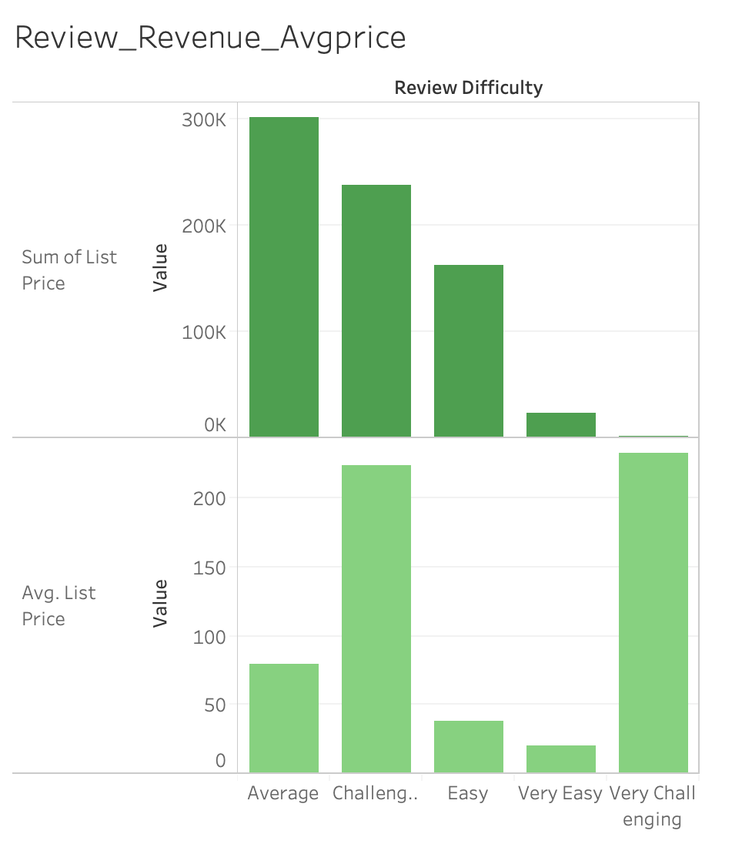
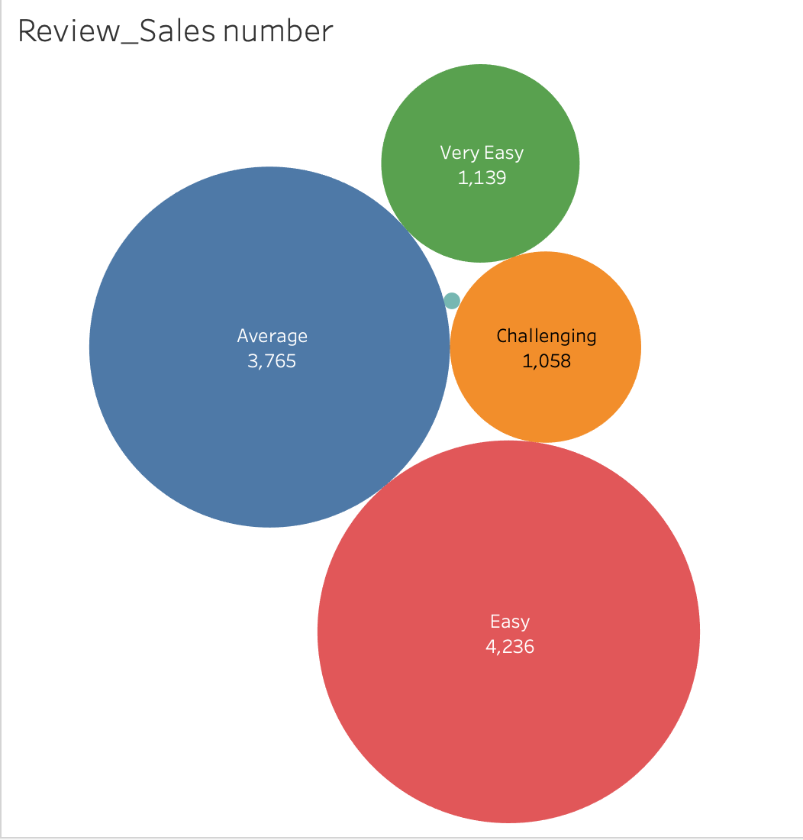

Revenue & Avg Price in Difficulty Level
From the 1st bar chart:
Average level and challenging level earn the most revenue
From the 2rd bar chart:
The average price for Challenging level is almost the same as the average price for very challenging level
Sales Numbers in Difficulty Level
From the review_sales number graph:
The sales number of easy level and average level rank 1st and 2rd while challenging level only sold 1058 sets in total.
Compared with bar charts:
If Lego group has a high profit margin in challenging level sets, one suggestion is that they can increase the production of challenging level sets to earn more profits.

Slide 25
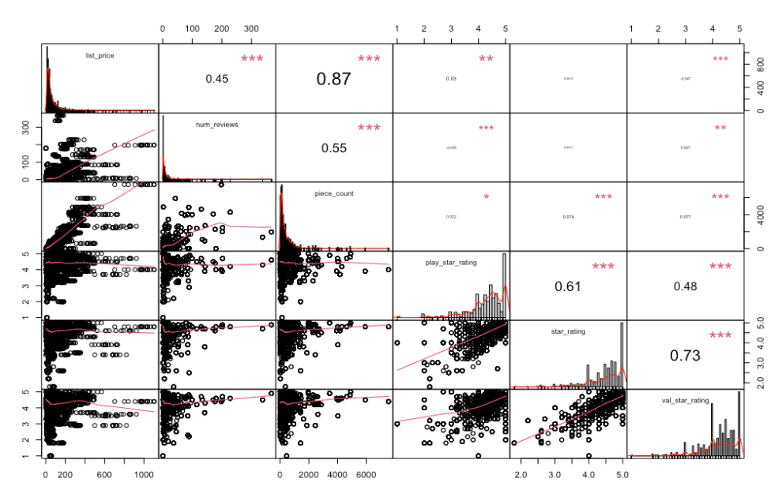
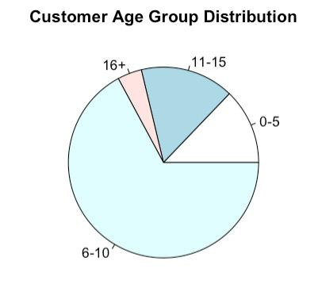
Price Analysis
Highly corrected pairs
list_price vs. piece_count
play_star_rating vs. star_rating
star_rating vs. val_star_rating
Customer age distribution
Majority of the lego sets are designed for customers between age 6 - 10.
Small proportion for 16 +

Slide 26
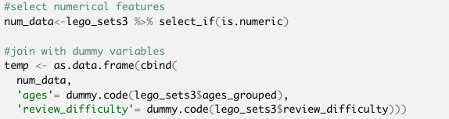
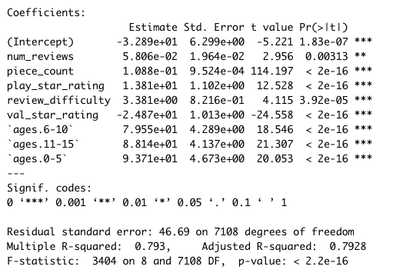

Modeling
Create dummy variables for categorical variables
Train: 70% Test: 30%
Backward stepwise selection
Model performance: adjusted R² =0.7928
Next step
Other models
PCA analysis to reduce dimensionality
Get more price related data to better understand price influencers

Slide 27
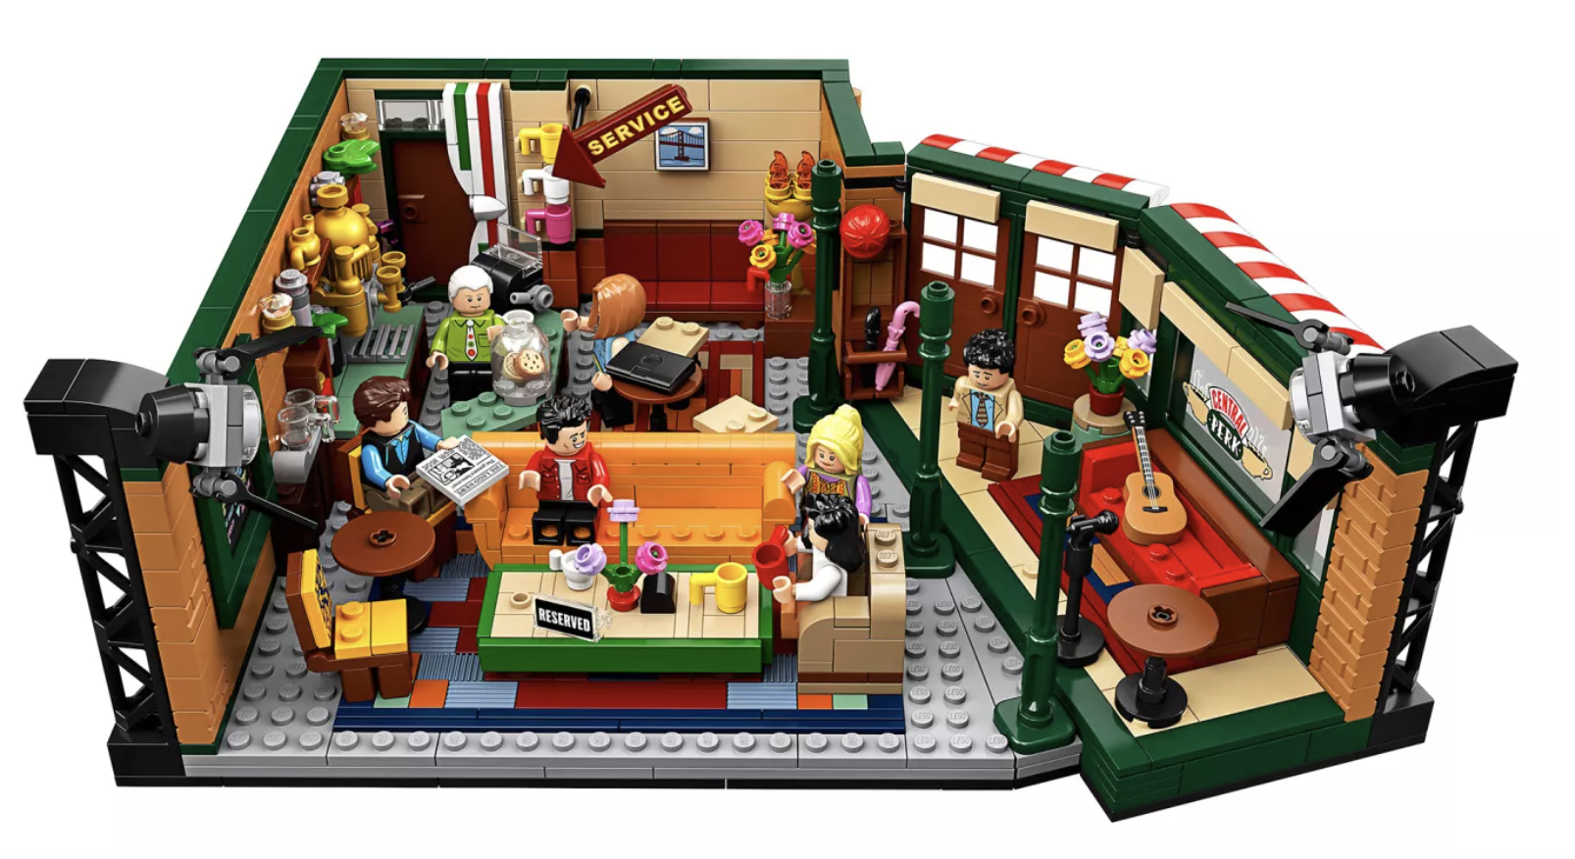
Recommendation
Explore Asian markets: fast growing area, include more relevant data
Promote collaboration: popular IP(intellectual property), customer communities
Improve popular product’s playability
Adjust production based on profit margin
Grab the market trend

Slide 28
Thank You!

